Slide 1

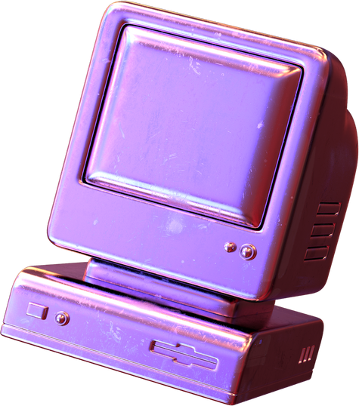
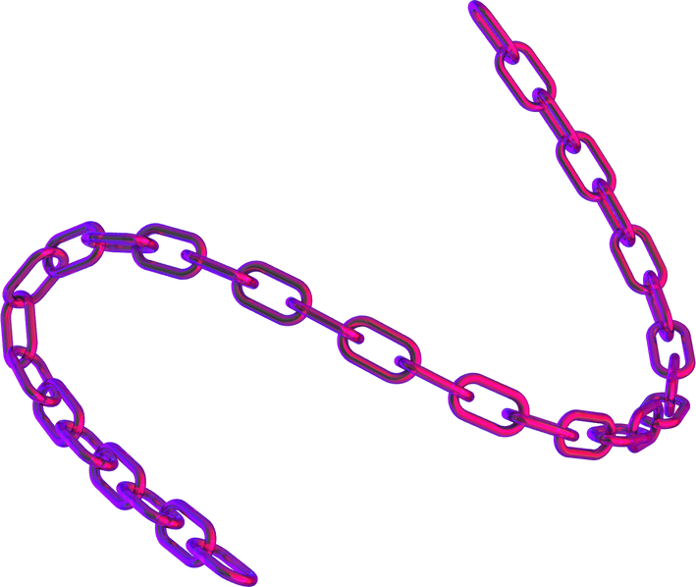

RFID Security
Suchit Reddi

Slide 2

What is RFID?
What is RFID used for?
Components of RFID network
What are the security risks?
What are the solutions?
Commercial RFID security
RFID Explained
What will you learn?

Slide 3
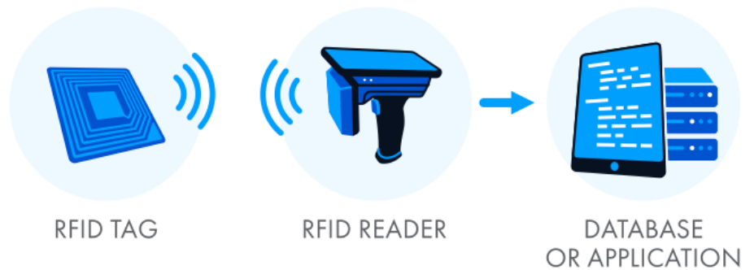
What is RFID?
Radio Frequency Identification (RFID) is a wireless system comprised of these components: tags, readers, and a database.
The reader has one or more antennas that emit radio waves and receive signals from the RFID tag.
It allows for non-contact, non-line-of-sight communication and is useful in asset management and tracking.
Combining RFID with IoT results in the gathering and analyzing massive amounts of information for decision-making.

Slide 4
History
RFID has been around since the dawn of the 20th century.
In the 1970s, RFID began to take shape into its modern form.
In 1973, the patent was granted to Mario W. Cardullo.
The ‘80s and ‘90s saw the development of passive and active RFID, which was mostly used in military and industrial applications.
The 2000s witnessed RFID spreading into various industries.
In the present day, with innovations like NFC and IoT, RFID continues to evolve and expand into a bright future.

Slide 5
What is it used for?
Your ID card might have an RFID tag inside it!
Access control: Controlling access to secure areas by attaching RFID tags to employee badges.
Asset tracking: Anything you can place a sticker on can be tracked.
Supply chain management: Placing RFID tags on containers and packages allows companies to track goods moving through their supply chain.
Product Authentication: RFID tags on products store info about it‘s origin, manufacturing date and batch number avoiding counterfeits.

Slide 6
What is it used for?
Inventory management and Logistics: Allows entities to track inventory down to the level of individual items.
Healthcare: RFID wristbands can store patient information and track the patients within the facility. Improves delivery of healthcare.
Payments: Contactless payments use NFC, a subset of RFID.
Libraries, transportation, and animal identification are a few other use cases of RFID technology.

Slide 7
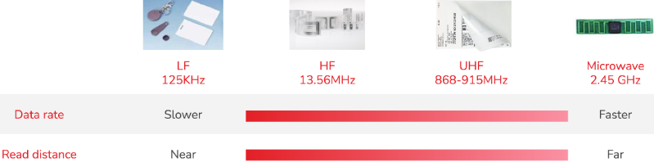
Technical Details
Low-frequency RFID tags: Frequency 125-134 kHz. Range 10cm. Data rate < 10 kbit/s. Less sensitive to interference. Used in access control.
High-frequency/NFC tags: Frequency 13.56 MHz. Range 10cm-1m. Data rate 106-424 kbps. Used in contactless payment.
Ultra-high-frequency tags: Frequency 868-915 MHz. Range 20m.

Slide 8

NFC (Near-Field Communication)
How is it different from RFID?
Developed by Philips & Sony. NFC can be considered as a subset of RFID.
NFC does not range from 25-100m, unlike RFID. Its range is 0-5cm only.
NFC takes advantage of the short-read range limitation of radio frequency.
There are active and passive NFC devices that support these information exchange modes: peer-to-peer and read/write.
Peer-to-peer mode allows two-way information exchange. The transmitting device is active, while the receiving device is passive.
Read/Write mode allows only one-way data transmission. An active NFC (card-reader) device reads data from the passive device (card).

Slide 9
Components of RFID Network
An RFID system/network consists of three main components:
RFID Tag:
Attached to the item being tracked.
Contains a microchip and an antenna.
Responsible for storing and transmitting data to the reader.
Can be passive or active based on the energy source.
RFID Reader:
Consists of an RF module, processor, and database connection.
Responsible for transmitting RF energy to activate the tag.
Receives the data transmitted by the tag.

Slide 10
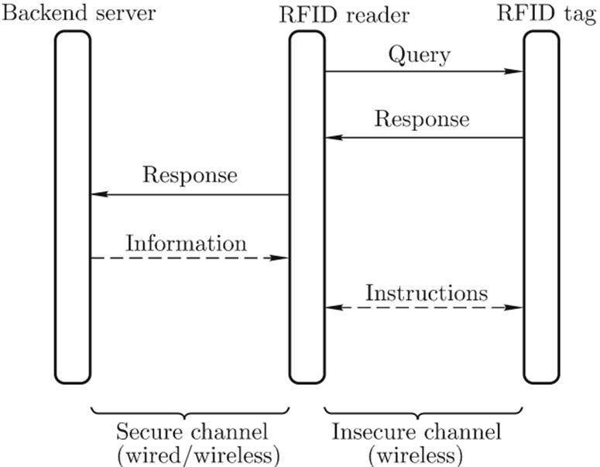
Components of RFID Network
Database or Host system:
Software or Hardware infrastructure that manages and controls the RFID system.
Consists of a computer, server or cloud-based platform.
Communicates with the RFID readers, collects and analyses the data collected from RFID tags.

Slide 11
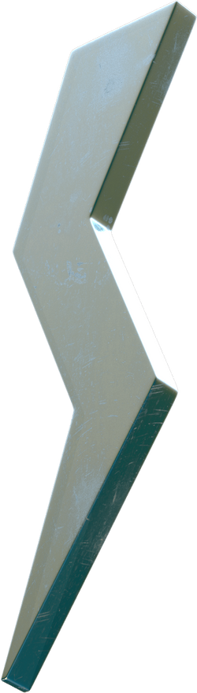
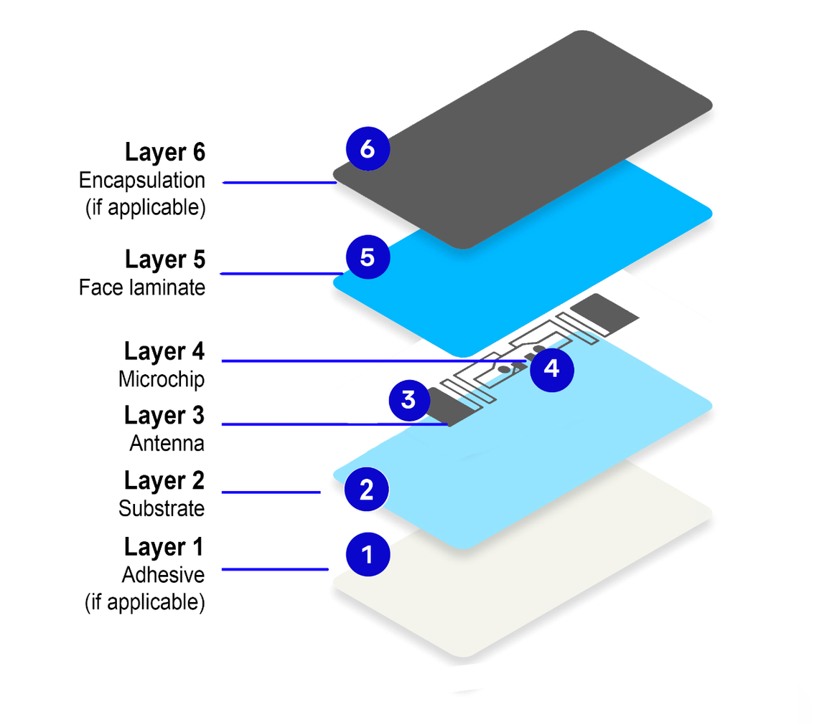
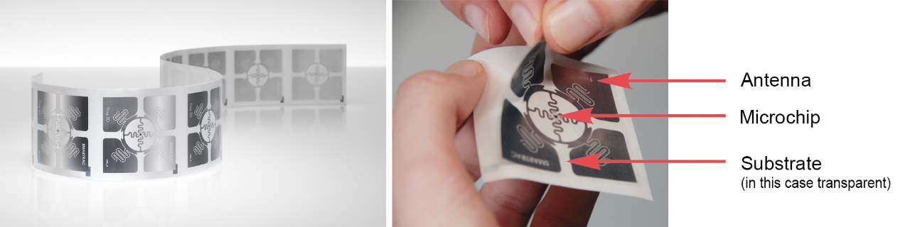
RFID tag construction
Adhesive secures the tag to the item.
Substrate holds the antenna and microchip together.
Antenna is made of copper or aluminum, resonant at a frequency.
Microchip/Integrated circuit performs the necessary data processing.
Face laminate provides stiffness, dust and UV protection to the tag.
Different types of tags: Hard, Dual-frequency, and sensor tags.
How does RFID work?

Slide 12
Implementing encryption in most tags is difficult due to low computing power.
RFID tags can’t identify which requests are from legitimate readers.
Reader and database are vulnerable to attacks affecting servers and ICs.
RFID is susceptible to passive eavesdropping and active interference.
Security
What makes RFID vulnerable?
Requirements:
Prevent unauthorized access.
Prevent illicit tracking.
Detect skimming.
Provide non-repudiation.

Slide 13

Attacks on RFID
Illicit Tracking - Even most encryption-enabled tags give the same output every time a query is made. This allows hackers to track the tag.
Skimming - Attacker goes around with a reader collecting data. Mostly seen in contactless payment cards.
Insert Attacks - Attacker tries to send system commands instead of normal RFID data. Similar to SQL Injection attacks on web applications.
Jamming - Generating a stronger signal than the RFID reader to disrupt it.
Brute Forcing - With adequate base info, guessing RFID IDs has more probability of succeeding.
Targeting database - Vulnerabilities of the database that manages the RFID network is a completely different rabbit hole.

Slide 14
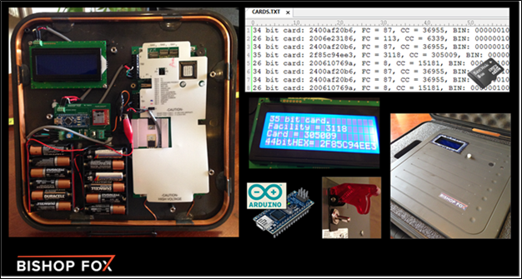
Attacks on RFID
Power Analysis - A unique attack method that uses the difference in the size and power levels of correct and incorrect responses during reconnaisance.
Eavesdropping & Replay - The attacker monitors the communication, and captured signals are replayed later without any modifications.
Denial of Service - Jamming the system with noise interference, blocking radio signals, disabling tags or creating invalid RFID responses to overwhelm reader.
Cloning & Spoofing - Usually done back-to-back, cloning is duplicating pre-existing tag data, and spoofing is using the cloned tag to gain access. Cloned tags can be used to lower prices of expensive items too.

Slide 15
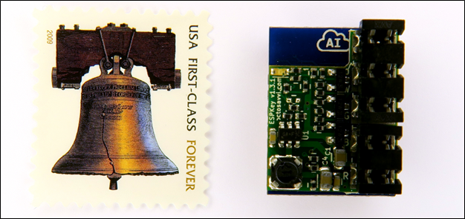
Attacks on RFID
MITM - A device is used to intercept, decode, and manipulate the information. Hacker diverts original signal and sends false data pretending to be the tag. When the user passes their tag to the reader, the signal is copied for later use but is forwarded without manipulation to avoid suspicion.
Another type involves placing a small hardware in line with the reader and the controller responsible for validating tag credentials.

Slide 16

Spoofing attack from Mr. Robot
Uses a device called “Tastic RFID Thief”

Slide 17
Solutions
Hardware-based - Doesn’t depend on the manufacturer.
Clipped tags: Separates chip from the antenna when the tag is not used (irreversible)
Blocker tags: Blocks the RFID signals from reaching the tag (even authentic)
Guardian device: Intercepts reader signals and allows only authorized ones.
Implementing Incident and Event monitoring in case of unusual activity.
Adding electrical circuits which will break if additional hardware is added.
Protocol based - Might be costly for manufacturers.
Cloning attacks: Sharing a private key with tags beforehand.
Tracking attacks: Using random numbers along with hash.

Slide 18
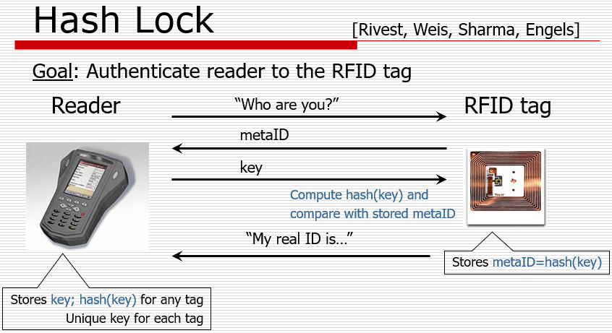

Slide 19
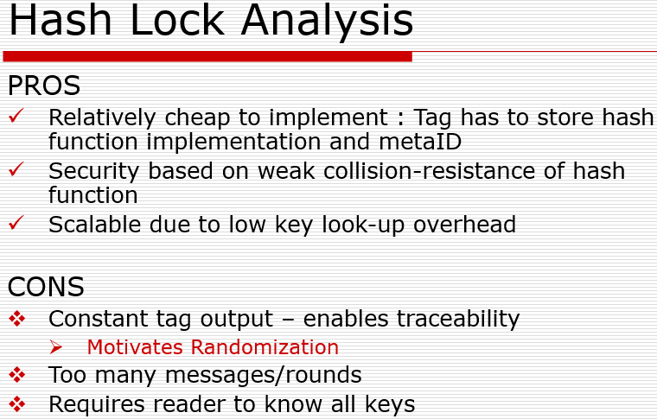

Slide 20
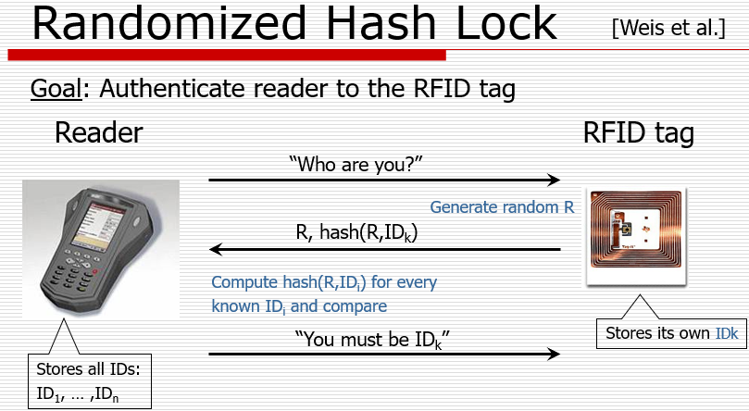

Slide 21
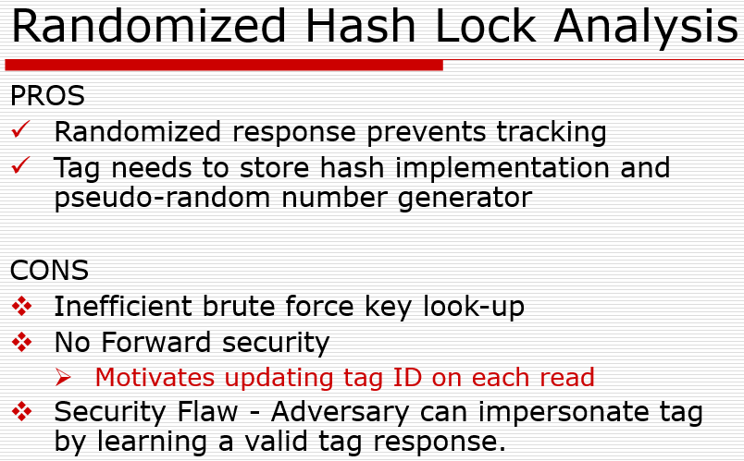

Slide 22
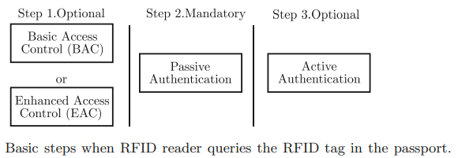
Commercial RFID Security
Background on RFID-enabled Passports
The RFID tag within the passport contains data relating to the passport holder, for instance, the height or photograph of the passport holder.
Since the RFID tag has limited storage capacity, a hashed result of such information is stored in the RFID tag.

Slide 23
Commercial RFID Security
Background on RFID-enabled Passports
The first step is to regulate access to the data contained within the RFID tag. We will discuss this in the future.
The second step in the verification process is mandatory. Passive authentication aims to verify that the data contained within the RFID tag is valid.
When the passport is first issued, information about the holder is hashed and signed with a secret key associated with the country that issued the passport. In the passive authentication step, the hashed data and signatures are verified using the public key associated with the country.
In Step 3, the RFID tag itself is authenticated. Step 3 requires the RFID tag to perform public key operations.
In active authentication, the RFID reader will send a random number over to the RFID tag, which will digitally sign the number and return the signature to the reader.

Slide 24
Commercial RFID Security
Basic Access Control Protocol (BAC)
The motivation for implementing BAC is to prevent skimming and eavesdropping.
An RFID tag that runs BAC has to be able to perform symmetric key operations. The tag will store two symmetric keys permanently, Kenc and Kmac. These two keys are computed when the passport is first issued to the passport holder.
The goal of BAC is to allow the RFID reader and the RFID tag to eventually derive a session key KSenc and KSmac to encrypt future transactions.
The RFID enabled passport computes Kenc and Kmac using a function of
<Passport number, Passport holder’s date of birth, and Passport’s Expiry date>

Slide 25

Commercial RFID Security
Basic Access Control Protocol (BAC)
After the RFID reader issues a query, the tag will respond with a random number nt.
The reader will execute Step A, which consists of the following substeps:
Generate 2 random numbers, nr and kr.
Compute Zr = nr|nt|kr
Compute Xr|Yr, where Xr = E(Zr, Kenc) and Yr = h(Xr, Kmac)

Slide 26
Commercial RFID Security
Basic Access Control Protocol (BAC)
After the tag receives Xr|Yr, the tag will execute Step B.
In this step, the tag will first verify Yr using Kmac, and then decrypt Xr to obtain Zr. The tag will check whether the nt value in Zr is the same as the value transmitted earlier.
The tag will only continue executing if this nt matches. The tag will finally compute Xt|Yt as follows:
Generate random kt.
Zt = nt|nr|kt.
Compute Xt|Yt, where Xt = E(Zt, Kenc) and Yt = h(Xt, Kmac).

Slide 27
Commercial RFID Security
Basic Access Control Protocol (BAC)
Upon receiving Xt|Yt, the reader will execute Step C. Here, the reader will first verify that Yt is valid using Kmac, and then decrypt Xt, and check whether the nt value contained within Zr is the same value it transmitted earlier.
Finally, in Step D, both the reader and tag will compute the session keys KSenc and KSmac using the value of Kr XOR Kt as seed. Subsequent communications between the reader and tag will be protected using KSenc and KSmac.

Slide 28
Commercial RFID Security
Security Analysis
A passport that only implements passive authentication does not meet the security requirements. There is no access control mechanism, and thus any reader can query the tag and obtain the same information.
Since the information returned by the passport is uniquely tied to the passport holder, passive authentication does not prevent illicit tracking. Finally, there is no protection against skimming.
The adversary can simply query the tag, and then store the response from one passport onto another, to create a fraudulent passport.

Slide 29
Commercial RFID Security
Security Analysis - Solution
The use of BAC can partly address these problems.
Let us assume that the adversary does not have the information of Kenc and Kmac, i.e. the passport number, date of birth, expiry date of the passport is unknown to the adversary.
The adversary querying the tag will be unable to get further than Step B, since the adversary cannot return the Xr, Yr values.

Slide 30
Commercial RFID Security
Security Analysis - Solution
Since all reader and tag communication is encrypted with Kenc, the adversary learns no information through eavesdropping.
Illicit tracking requirement is satisfied because the tag returns a different nt each time it is queried.
Finally, since the adversary does not know Kenc and Kmac, a fake tag created by the adversary will be detected by a legitimate RFID reader.

